Slide 1
Ray Tracing II
A More Practical Version

Slide 2
A QUICK REVIEW

Slide 3
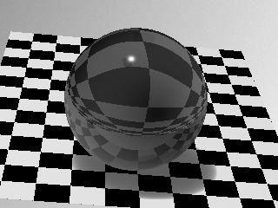
HW2 (Part B)
Material: M r g b Ka Kd Ks exp Reflect
  (r, g, b) is the surface color;
  Ka, Kd, Ks are the coefficients of the ambient, diffuse, and specular components; exp is the specularity;
  Reflect is the ratio of reflection.
Applies to all subsequent objects until the next material setting appears.

Slide 4
Creating a Ray
Parameters:
  Image Plane (position, size, and resolution)
  Viewpoint
  Which ray (x, y)?

Slide 5
Assignment 2 Hints
Convert eye position, view direction, and field of view into screen corner positions:
Then divide the screen into w*h pixels.

Slide 6
Lighting (Shading) & Shadow
Point light is easy to implement.
How to determine a surface point is in the shadow? Use a shadow ray (from intersection point to light).
Shading will be introduced in the next lecture.

Slide 7
Reflection and Refraction
Reflected ray is determined by:
  incoming ray and normal vector.
Refracted ray is determined by:
  Incoming ray
  Normal vector
  And density
Snell’s law:
η_{I} sin θ_{i} = η_{t} sin θ_{t}
θ_{i}
θ_{t}

Slide 8
SHADING, REFLECTION, REFRACTION

Slide 9
Shading Models
Pixel color = ambient + diffuse + specular + reflected + transmitted
The weight of each is determined by the surface properties.

Slide 10

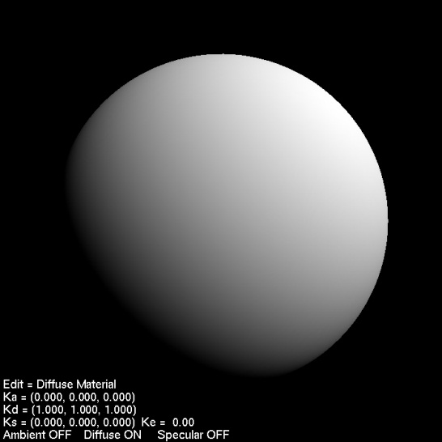
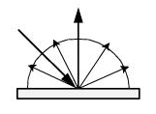
Diffuse Component
Id = Ii * N·L
Not affected by viewing direction.
  i.e., incoming light is reflected
  to all directions.
L
N

Slide 11
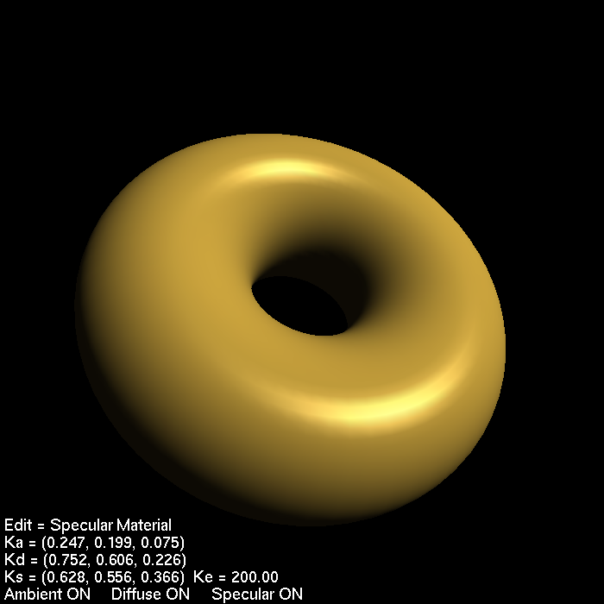
Glossy (Specular) Component
(Phong裴祥風Reflection Model)
To model imperfect reflection.
Is = Ii(N · H)^{n}
L
H
N
V

Slide 12
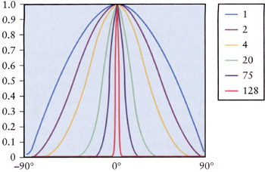
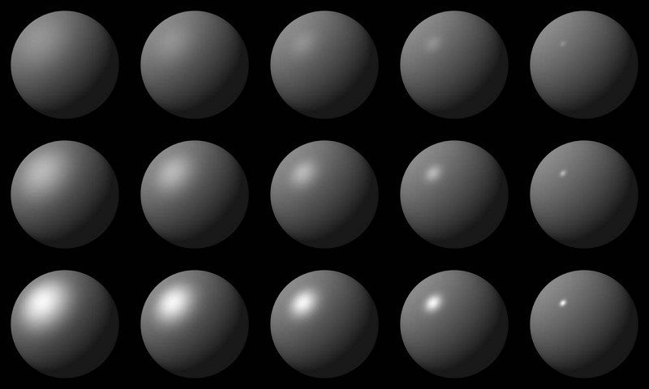
Phong Specular Term
https://cg2010studio.com/2011/10/04/phongs-specular-term/
An interesting demo at:
  http://www.cs.toronto.edu/~jacobson/phong-demo/

Slide 13
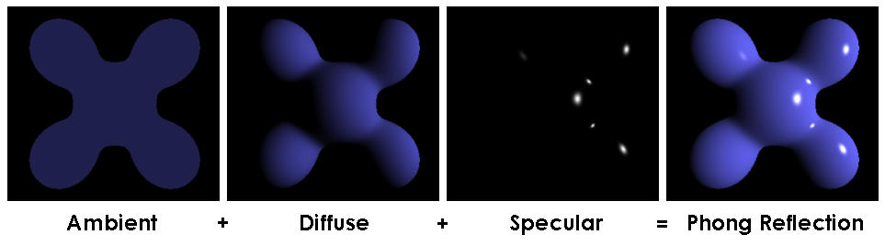
Phong Reflection Model
I = Ka*Ia + kd*Id + Ks*Is
Not completely correct, but good enough.
specular
diffuse
ambient

Slide 14
“But, they all look like plastic…”

Slide 15
Other Reflection Models
Pharr’s 9.4: other microfacet models
  Oren-Nayar
  Torrance-Sparrow
  Blinn microfacet distribution
  Anisotropic microfacet model
Pharr’s 9.5: Lafortune model
Models for particular materials: e.g., for finished wood (in SIGGRAPH 2005)

Slide 16
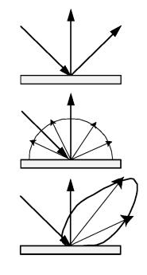
Specular Component
(Cook & Torrance Model)
Consider specular reflection as perfect reflection of micro-facets. (See Watt’s Section 7.6)
Specular=DGF/(N·V)
  D: Distribution term
  G: Geometry (shadowing and masking) term
  F: Fresnel term

Slide 17
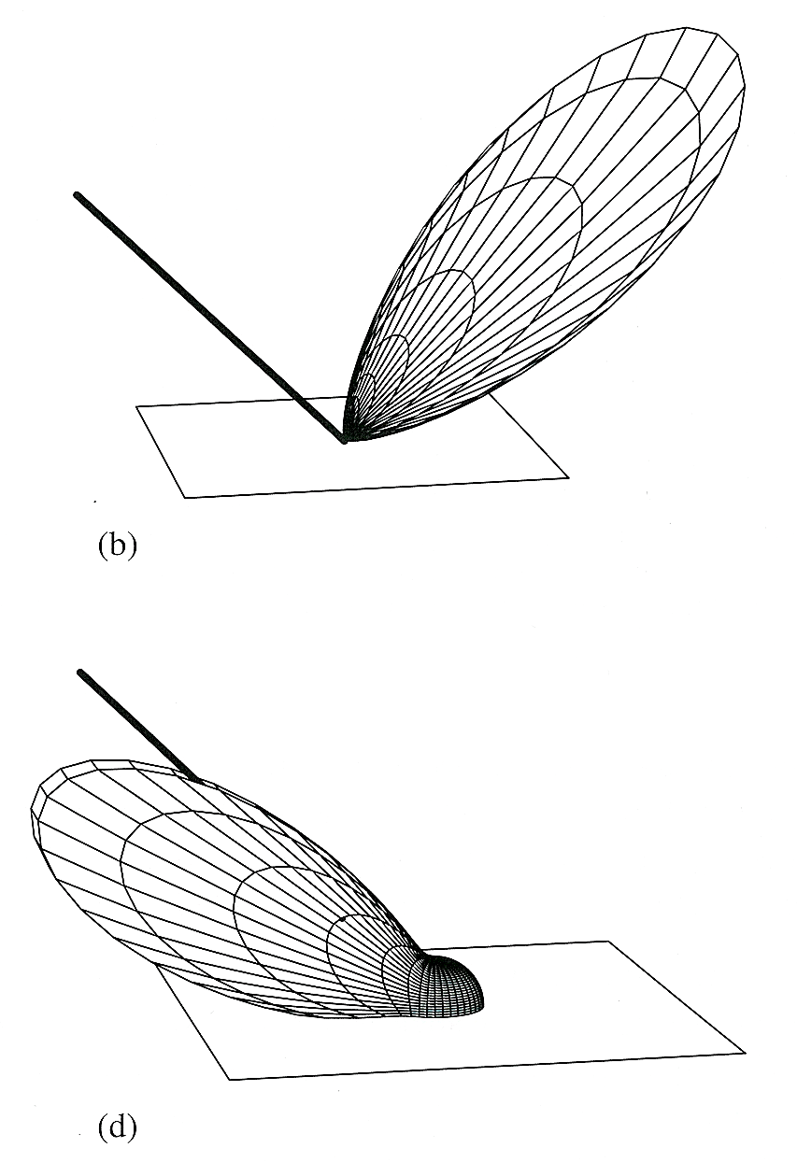
Lafortune Model
Phong model assumes the glossy reflection (lobe) appears in the direction opposite to the incident light.
This assumption is relaxed in the Lafortune model.
Multiple lobes can be used.

Slide 18
“Now, are all materials covered?”
No!
Let’s try a sample-based method instead…

Slide 19
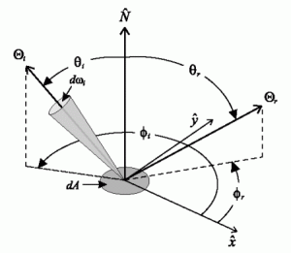
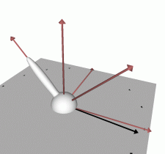
BRDF
BRDF=f(θ_{in}, φ_{in}, θ_{ref}, φ_{ref})=f(L,V)

Slide 20
Watch Out for Subtly in BRDF!
Ask yourself these questions:
  Why not just consider N · H as in the Phong’s glossy term? (Hint: Does incidence matter?)
  Does φ_{in} really matter?
  Difference between isotropic and anisotropic
  reflection!

Slide 21
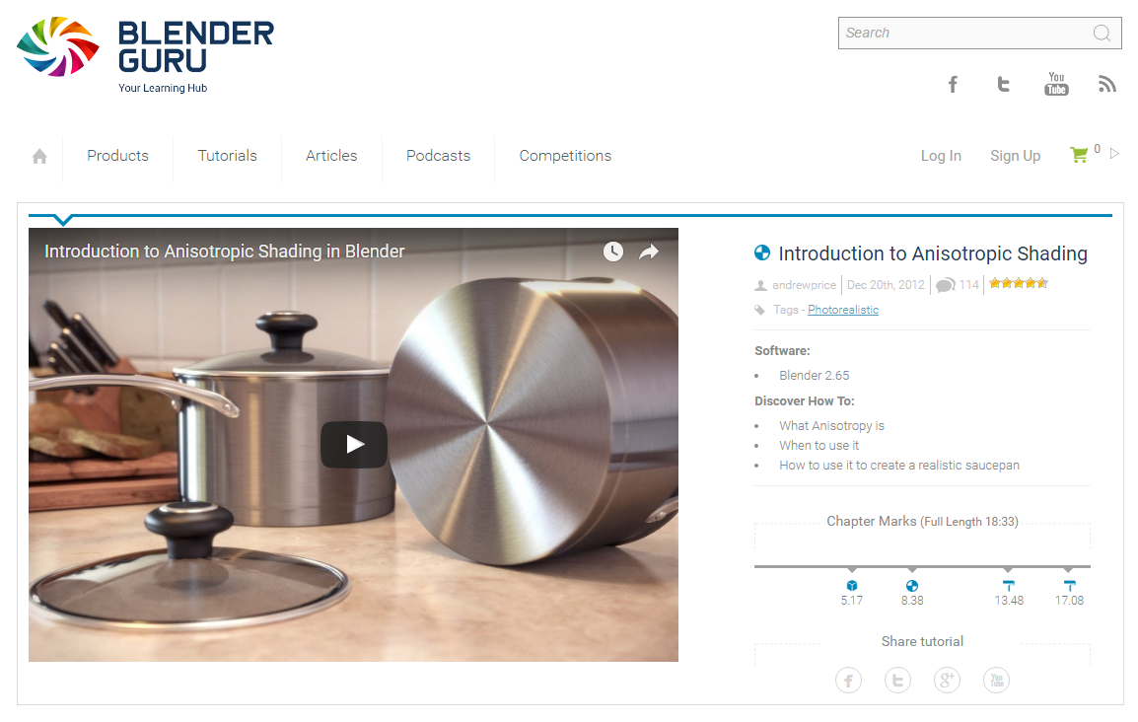
Anisotropic Shading in Blender
See the tutorial in Blender Guru for an example.
From http://www.blenderguru.com/tutorials/an-introduction-to-anisotropic-shading/

Slide 22
Why Not Always Using BRDF?
Difficult to find a “closed form” representation of BRDF.
The Phong model and Cook & Torrance model are approximation of BRDF.
  They are not 100% match of BRDF, but they are easy to compute.

Slide 23
Local vs. Global Illumination
Local – each surface is influenced by the light source only.
Global – each surface is influenced by the light source AND ALL OTHER surfaces.

Slide 24
Combining Shadow, Reflection and Refraction
Trace rays recursively to detection shadow and add reflection and refraction, then compute a weighted average.
An example “shade tree”:
Shadow?
1
10% reflection
80% refraction
2
3

Slide 25
Advanced Ray Tracing
Make it fast.
Make it better.
  Anti-aliasing
  Distributed Ray Tracing

Slide 26

Anti-Aliasing
Super(or Over)-sampling
Adaptive vs. Non-adaptive
Uniform vs. Jittered
Detail coming in a future lecture

Slide 27
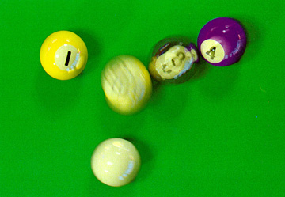
Distributed Ray Tracing
Published by R. L. Cook in 1984.
Antialiasing
Motion blur
Depth of field (camera)
Ideas behind other so-called Monte Carlo methods.

Slide 28
ACCELERATION

Slide 29
Common Operations in 3D
Line/object intersection
  Given a ray or line, which object will it intersect?
View frustum culling
Collision detection

Slide 30
A Motivating Problem
Which one of the following takes more time to render?
A small bunny
  With more than 10K triangles.
  Covers about 5% of the screen
A large sphere
  Covers about 50% of the screen
Why spending so much time with so little gain?

Slide 31
Bounding Volumes
The following shows a triangle and its (axis-aligned) bounding box.
Is it faster to check the intersection with a bounding box or triangle?
What about an object with many triangles?
Can we use other shape as the bounding volume?

Slide 32
Sorting/Indexing in 3D
Sequential search is too slow for large models.
How about storing them in a 3D array?
  Size will be overwhelming
Think “hierarchy”

Slide 33
Grid
Simply divide the bounding box of the whole 3D space into NxNxN uniform sized boxes (or voxels).
Note that a primitive may overlap with many voxels.
Q: What is the potential speedup?
Q: What is the magic number N?

Slide 34
Octree
Divide the space in halves in X/Y/Z.
  Always split in the middle.
  You may also consider them as splitting in X, then in Y, then in Z.
If too many objects are in a partition, divide them again (recursively).

Slide 35
K-D Tree
More flexible than octree:
  Not always splitted in the middle.
  Split in X, then in Y, then in Z, or any order.
Rules to select the split positions?
  Considering the number of primitives?
  How about the size or surface area?
  A popular choice is the Surface Area Heuristic (SAH)

Slide 36
Kd-tree Example
4
6
1
10
8
11
2
3
3
13
2
4
5
6
7
12
9
8
9
10
11
12
13
Figure Source: CS638 slides by Stephen Chenney, University of Wisconsin – Madison,
5
1
7

Slide 37
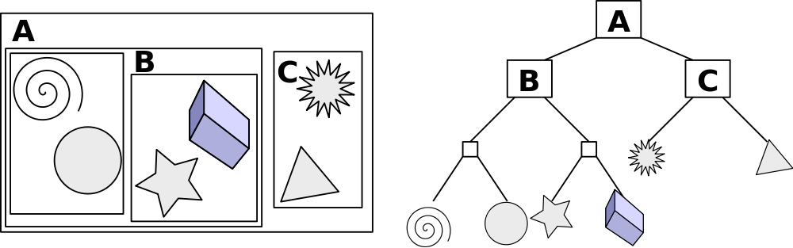
BVH (Bounding Volume Hierarchy)
The spatial hierarchy adheres to the objects more closely than grid, kd-tree, …etc.
The bounding volume is not limited to axis-aligned boxes.
Creative Commons Attribution-Share Alike 3.0 Unported license
Source: http://en.wikipedia.org/wiki/File:Example_of_bounding_volume_hierarchy.svg

Slide 38
Accelerator
Grid, kd-tree, octree, bounding volume hierarchy (BVH)…etc. are examples of “accelerators”
For more details, see Chapter 4 of PBRT 2nd Edition.

Slide 39
Speed Considerations
Q1: Is intersection test with a box fast?
  Nearly trivial for axis-aligned boxes!
Q2: How about cross-boundary objects?
  Add a “visited” Boolean flag.
Q3: What is the computational complexity?
  O(log N) intuitively speaking

Slide 40
Optional (Backup) Slides

Slide 41
BSP Trees
From the paper by Fuchs et al, “On visible surface generation by a priori tree structures” SIGGRAPH 80.
Binary Space Partition trees
  A sequence of cuts that divide a region of space into two
Cutting planes can be of any orientation

Slide 42
BSP Example
1
1
2
2
4
A
3
out
5
7
3
A
out
B
6
8
out
6
C
5
B
C
out
D
out
D
Figure Source: CS638 slides by Stephen Chenney, University of Wisconsin – Madison,
4
8
7

Slide 43
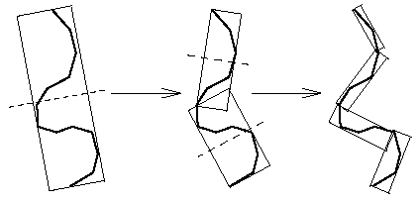
OBB Tree
OBB stands for Oriented Bounding Box.
OBB is a rectangular bounding box at an arbitrary orientation.
Asymptotically faster for close proximity situations.

